Slide 1

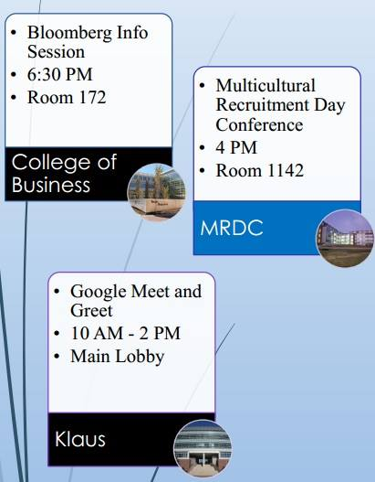
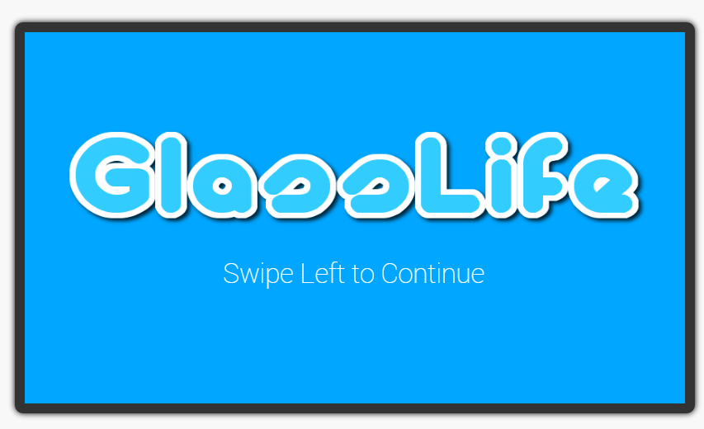
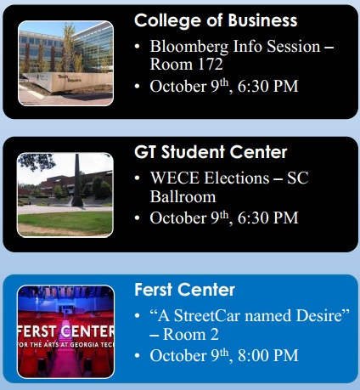
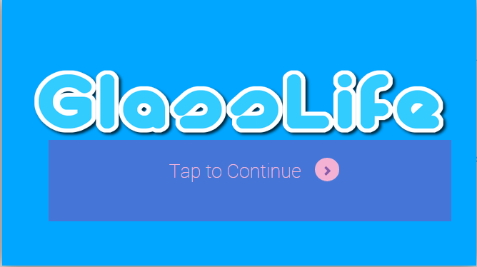
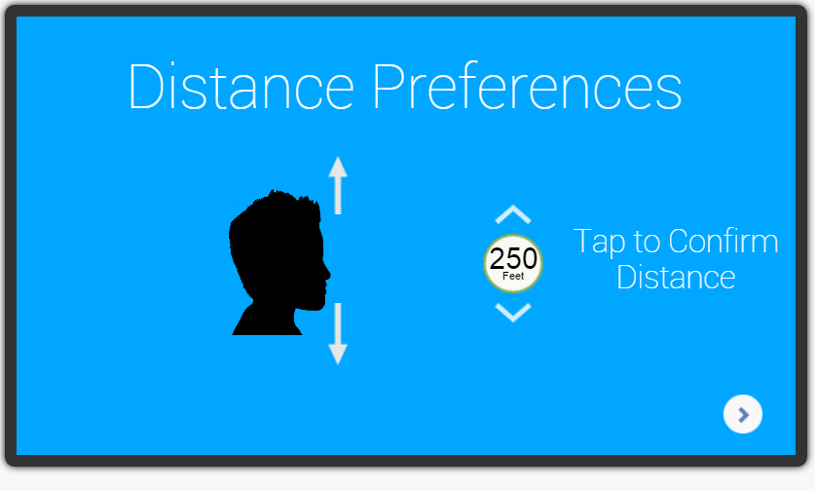
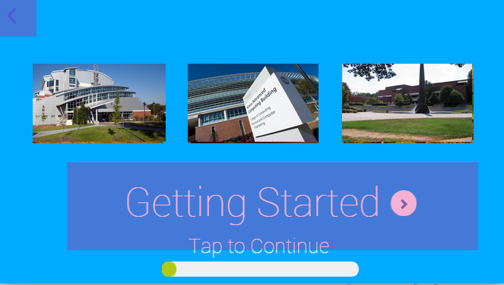
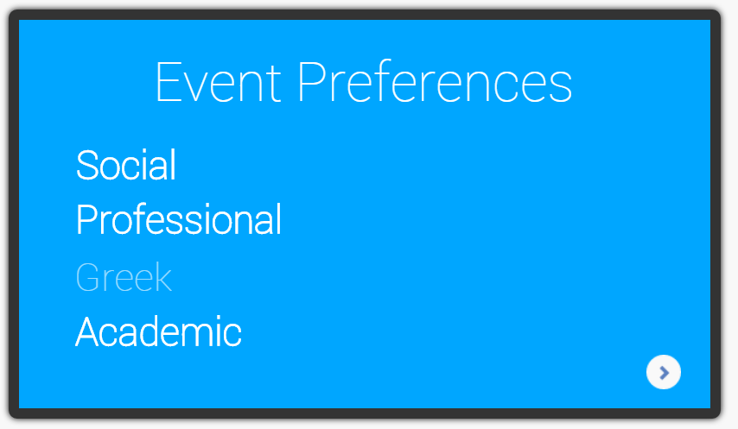
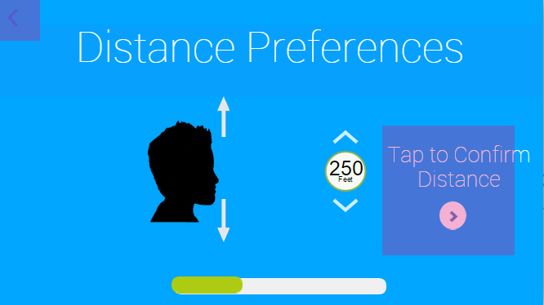
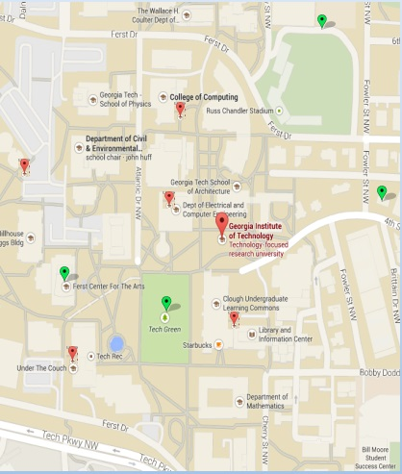
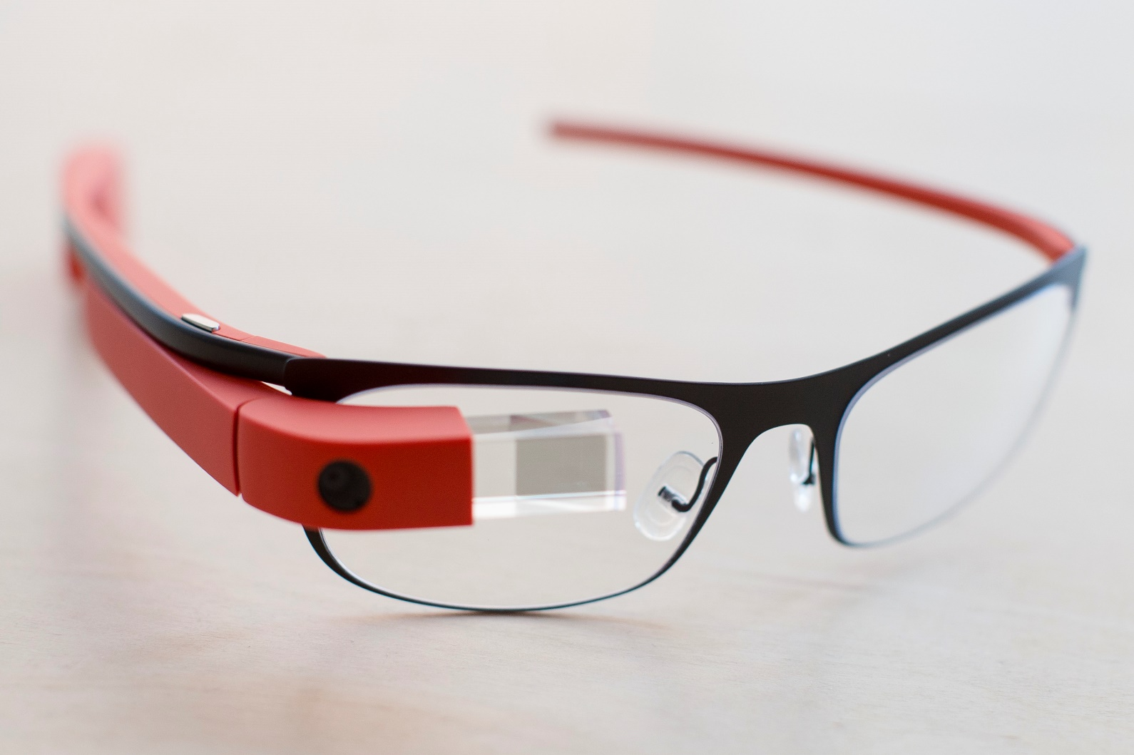
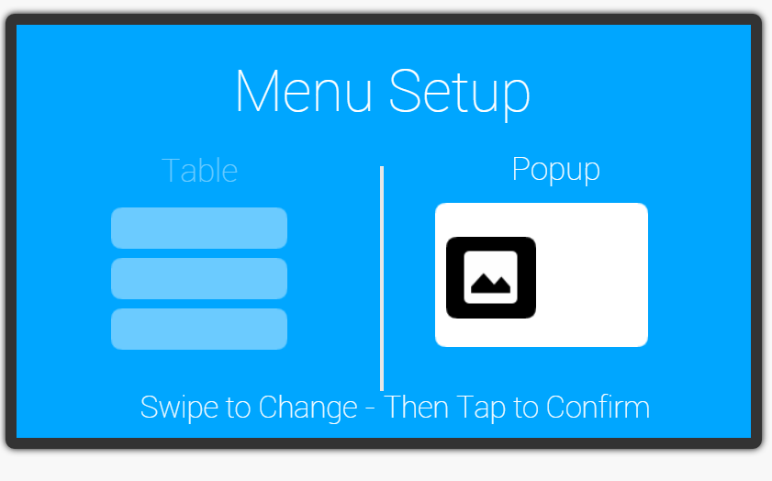
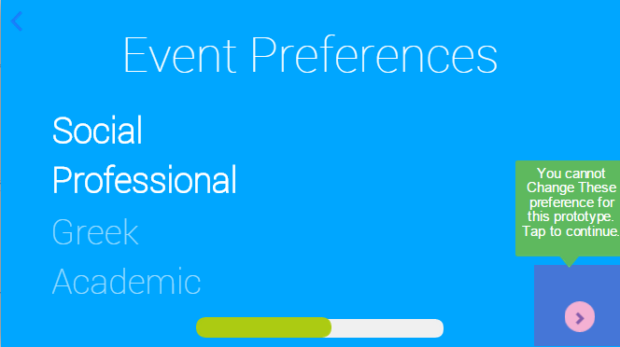
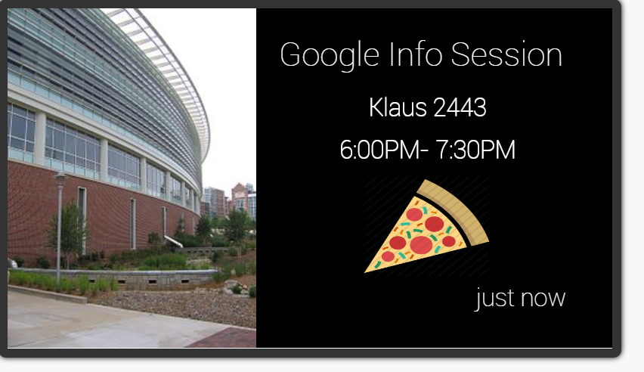
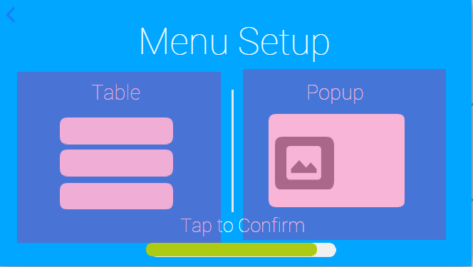
GLASSLIFE
Finding Free Food on Campus
Clarence Chang, Charles Ding, Sneha Ganesh, Nikhil Nandish
ABSTRACT
PREVIOUS DESIGN ALTERNATIVES
PROTOTYPE DESIGN
FINAL DESIGN
Our project is an application that works in association with Google Glass. It reports all events occurring on campus, for example:
Free food events
Volunteer Opportunities
Information Sessions
Seminars
Social occasions like: rush timings for fraternities & sororities
- Moved off of Google Glass to Mobile App due to poor google glass prototype support framework
- Added a progress bar to indicate to users their progress in the setup process
- Removed extraneous screens in the beginning that confused users and didn't add value
- Made arrows more consistent to prevent confusion
- Made everything more fluid and smooth
Changed swiping functionality to tap to increase reliability
Made tap locations surface area larger to reduce errors
Design 1: Live PopUp option
- When the user walks past an area where an event is occurring or going to occur in the near future, the application pops up a notification giving details about the event.
- Limited info: where? when? what?
Design 2: Tabular representation option
- This view lists in chronological order all the events taking place on campus in the vicinity of the user.
- User can click on a particular event to receive more information.
Design 3: Geographical representation option
- This view is going to look similar to that of Google Maps.
- The user will be able to see the map of the university campus and be able to see pins scattered across the map that represents Event locations.
- “Pin” is color coded to denote food availability.
- Gave user control in application settings
Distance
Type of view
- Chose prototype platform that allows for maximum visualization
- Simulate Glass environment through gesture commands
- Created both pop-up and table interface
WHY CHOOSE OUR APPLICATION?
Students:
Students remain unaware of a large portion of events on campus. Our application hopes to compile all event information in a central database.
Information is presented in concise manner.
Live updates for events based on current geographic location
Faculty and Staff:
Ease of access
No space restrictions
Free advertisement
Introduction
Settings
Pop-Up view
Menu View

